Slide 1
Insurance Charges Analysis
The aim of this project is to analyse customer data to identify the key factors that influence medical insurance charge.
Amna Riasat
Data Analyst

Slide 2
Dataset Overview
Source: Health Insurance Customer Data
Rows: 1338
Columns: 7
Key Features:
Age, Gender, BMI
Number of children
Smoking status
Region
Insurance charges
Business Context:
By analysing where expenses originate, we can optimise our pricing models and better anticipate financial vulnerabilities

Slide 3
Data Preparation
Steps Taken:
Checked for missing values - none were found.
Identified a duplicate record which was simply removed.
Verified correct data types for all variables.
Created BMI categories: Underweight, Normal, Overweight, Obese
Created Age groups: Young, Middle-aged , Senior
The outcome gave me a clean and consistent dataset ready for analysis.

Slide 4
Exploratory Analysis
Findings:
Insurance charges vary widely, indicating high cost variability.
Smokers have significantly higher average charges than non-smokers.
Insurance costs increase steadily with age.
Higher BMI is associated with higher charges.
Gender and region show relatively small differences.
This emphasises how lifestyle and age-related factors dominate cost difference.

Slide 5
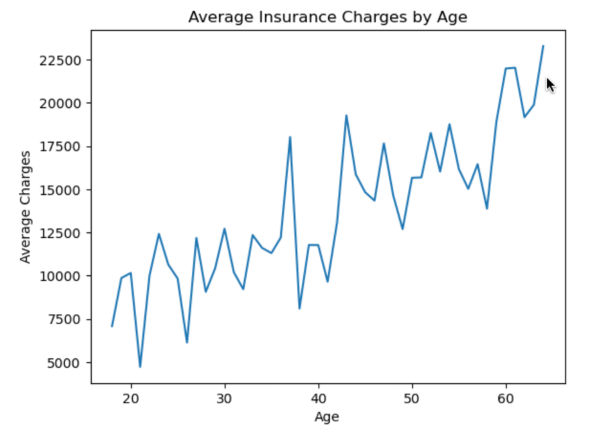
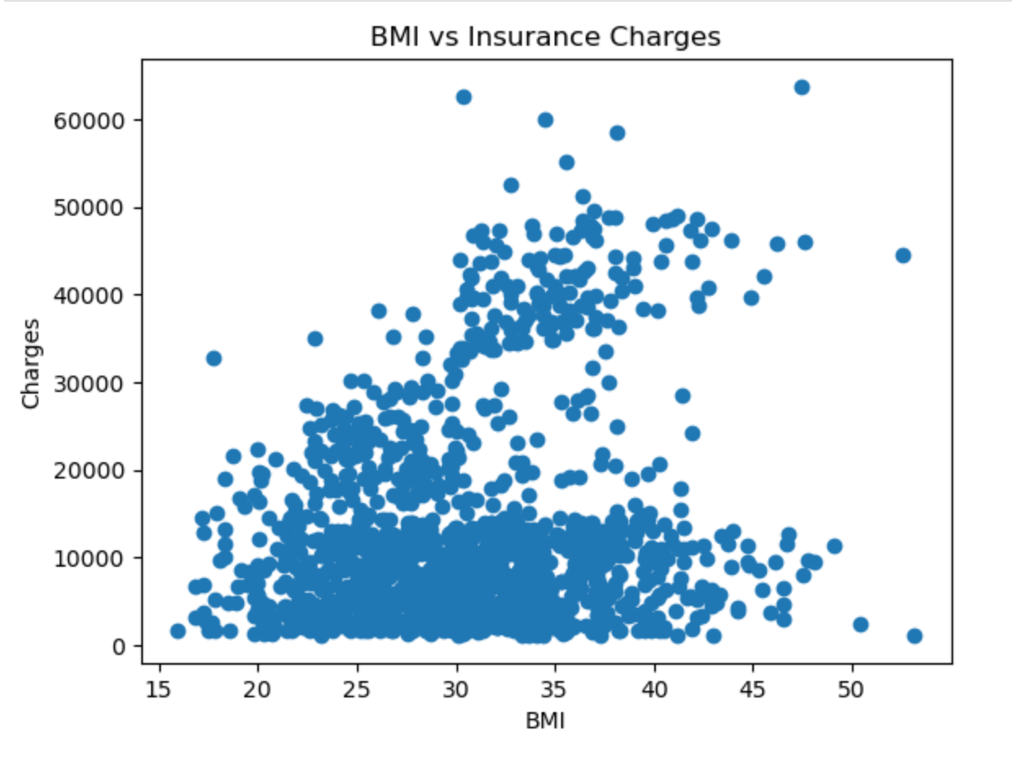
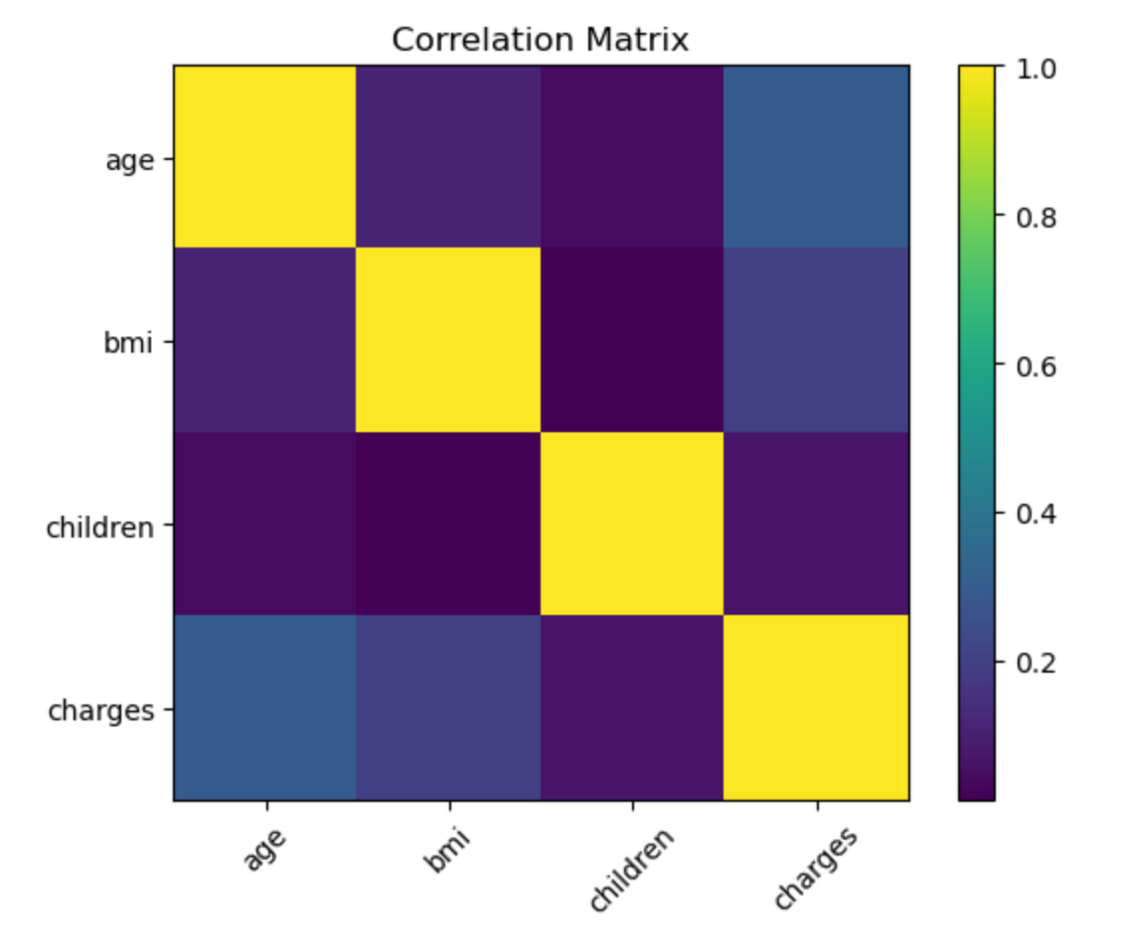
Matplotlib Visualisations
Seaborn was not available in the Pyodide environment. Therefore, equivalent visualisations were created using Matplotlib to meet the objectives.
The line chart shows that age is a major driver of insurance costs. Charges increase steadily as age increases, particularly for middle-aged and senior individuals.
The scatter graph indicates that BMI also influenced insurance charges. People with higher BMI, especially in the overweight and obese categories, tend to have higher costs.
The heatmap shows that age has the strongest positive correlation, followed by BMI, while the number of children has a much weaker relationship.

Slide 6
Key Insights
Smoking status has the strongest impact on insurance charges. Smokers consistently show much higher average and median charges compared to non-smokers.
Region and gender show some variation in charges, but their impact is relatively small compared to lifestyle and age-related factors.
Charges are right-skewed, which means there are very few high costs

Slide 7
Business Recommendations
Introduce incentives such as lower premiums for customers who quit smoking.
Offer smoking cessation programmes in partnership with heslthcare providers.
Promote preventive care and regular health screenings for older customers.
Use BMI categories to support early risk identification.

Slide 8
Closing and Reflection
Based on this analysis, I can clearly see that smoking status, age, and BMI are the strongest drivers of insurance charges due to their direct link to health risk and medical costs.
The findings provides actionable insights that support fair pricing and better decision-making.

